Slide 1

Programming Laboratory – V (SPOS) 18BTIS511 Assignment 5
Process control system calls - Fork, execve and wait system calls along with the demonstration of zombie and orphan states.
a) Application should consist of Fork –wait combination (parent with one application and child with another application) and students must demonstrate zombie and orphan states.
b) Application should consist of Fork –execve combination (parent with one application and child with another application).
Prepared By – Dr. Jyoti Malhotra
Prof. Pranav More

Slide 2
Process Creation – Unix/Linux
fork()
System call used to create new processes.
It takes no arguments and returns a process ID.
Return value of fork() - pid_t defined in sys/types.h
Negative | The creation of a child process was unsuccessful.
Zero | Is returned to newly created child process
Positive | Value is the process ID of the child process, and it is returned to the parent.
Process can use function getpid() to retrieve the process ID assigned to this process.

Slide 3
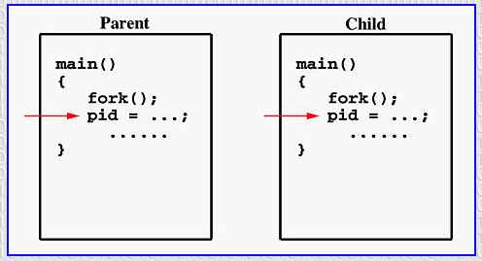
Process Creation – fork()
If the call to fork() is successful, Unix
Creates 2 identical copies of address spaces, one for the parent and the other for the child.
Both processes will start their execution at the next statement following the fork() call.
cid- Child ID
cid
cid

Slide 4
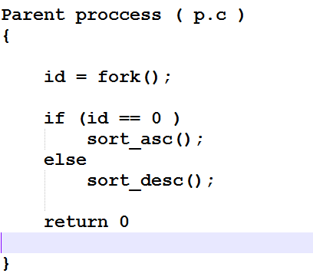

Slide 5
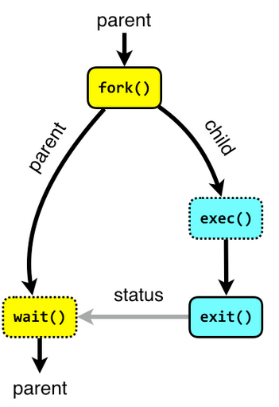
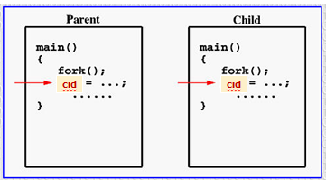
Process Creation – fork()
Both processes start their execution right after the system call fork().
As both processes have identical but separate address spaces, variables initialized before the fork() call have the same values in both address spaces.
Since every process has its own address space, any modifications will be independent of the others.
exec() system call used after a fork() to replace the process’ memory space with a new program
Notes:
http://www.it.uu.se/education/course/homepage/os/vt18/module-2/process-management/

Slide 6
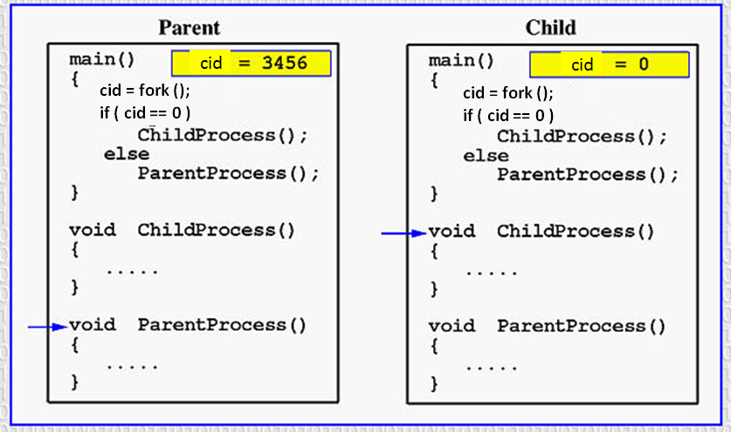
Process Creation – fork()
For child process: getpid() is 3456 and getppid() is say 3454
Notes:
Getpid – get process id
Getppid – get parent process id

Slide 7
System calls
fork()
fork - create a child process
#include <sys/types.h>
#include <unistd.h>
pid_t fork(void);
Creates a new process by duplicating the calling process.
The new process is referred to as the child process.
Returns the ID of the child process.
The calling process is referred to as the parent process.
The child process and the parent process run in separate memory spaces.

Slide 8
Fork template
int main(){
char str[20];
int arr[MAX];
pid_t cid;
accept_str(str);
accept_nos(arr);
cid = fork();
if( cid == 0 ) {//CHILD PROCESS
sort_desc(arr);
cnt_words(str);
}
else {
sort_asc(arr);
cnt_vowels(str);
}//end of if-else
return 0;
}//end of main
Notes:
Parent process - sorts array elements in ascending order
- Count number of vowels in the given sentence
Child process - sorts array elements in descending order
- Count number of words in the given sentence

Slide 9
System calls
sleep() - sleep for a specified number of seconds
#include <unistd.h>
unsigned int sleep(unsigned int seconds);
Causes the calling thread/process to sleep either until the number of real-time seconds specified in seconds have elapsed or until a signal arrives which cannot be ignored.
Uninterrutable
Returns - Zero if the requested time has elapsed, or the number of seconds left to sleep, if the call was interrupted by a signal handler.

Slide 10
System calls
getpid() - get process identification
getppid() - get Parent process identification
#include <sys/types.h>
#include <unistd.h>
pid_t getpid(void);
pid_t getppid(void);
getpid() returns the process ID (PID) of the calling process.
getppid() retuns the Parent PID of the calling process.

Slide 11
System calls
wait() - wait for process to change state
#include <sys/types.h>
#include < sys/wait.h >
pid_t wait(int *status);
The wait() system call suspends execution of the calling process until one of its children terminates.
It waits for the exit status of child process terminating with PID collected in pid_t.

Slide 12
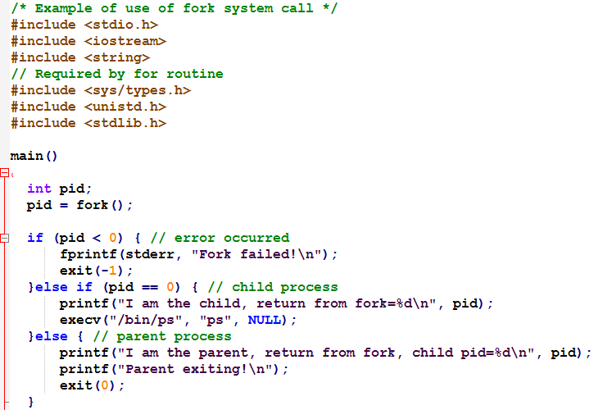
fork() example
execve() executes the program pointed to by filename. filename must be either a binary executable, or a script starting with a line of the form:
execve() does not return on success, and the text, data, and stack of the calling process are overwritten by that of the program loaded.
NEGATIVE
POSITIVE

Slide 13
References
Refer to manual pages of -
Fork()
Sleep()
Wait()
Simulate Zombie and Sleeping state by ps -ax command
man ps

